Slide 1
ALM TO SVN MIGRATION
Place: BlackRock Inc, Gurgaon
Project Owner: Jatinder Pal Singh Batra
Start Date: 12th January,2015
End Date: 10th July,2015
BY:
Nitish Kishore 101113034 CSE

Slide 2
ABOUT COMPANY
BlackRock, Inc. is an American multinational investment management corporation based in New York City.
BlackRock is trusted to manage more money than any other investment firm.
Our business is investing on behalf of our clients, from large institutions to the parents and grandparents, the doctors and teachers who entrust their savings to us.
We work only for our clients—period. Our promise is to offer them insight about what to do with their money and the products and services that can help them plan for a better financial future.
That's why companies, institutions and global governments come to us for help meeting their biggest financial challenges.
BlackRock manages $4.77 Trillion assets. It has !2,000+ employees in 70+ offices in 30 countries.

Slide 3
ALADDIN
Asset Liability Administrative Debt and Derivative Institutional Network
Aladdin® is an operating system for investment managers that connects the information, people and technology needed to manage money in real time.
The Aladdin platform combines sophisticated risk analytics with comprehensive portfolio management, trading and operations tools on a single platform to power informed decision-making, effective risk management, efficient trading and operational scale.
More than just technology, Aladdin powers Collective Intelligence by providing tools to help organization communicate effectively, address problems quickly, and make informed decisions at every step of the investment process.

Slide 4

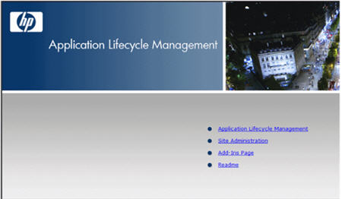
TECHNIQUES AND TOOLS USED
QTP
provides functional and regression test automation for software applications and environments.
It uses the Visual Basic Scripting Edition (VBScript) scripting language to specify a test procedure, and to manipulate the objects and controls of the application under test.
It works by identifying the objects in the application user interface or a web page and performing desired operations
ALM
ALM- test Management Tool by HP.
Application where the test scripts and test resources (Libraries and ORs, excel etc.) are stored.
Batch execution of automated scripts.
Creation of manual test cases and Capturing defects.

Slide 5
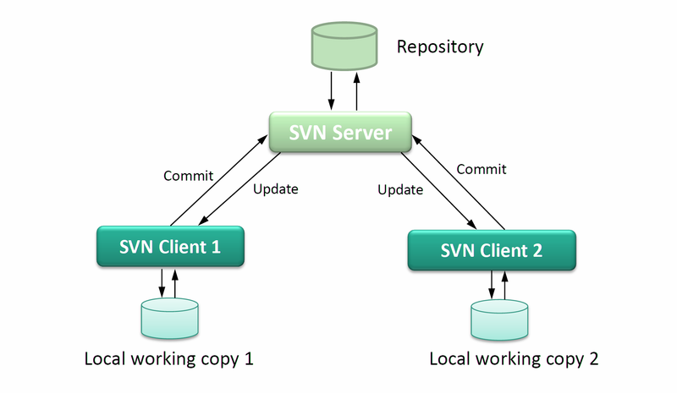
WHAT IS SVN?
SVN:
SVN is a software versioning and revision control system.
Open Source
Allows developers to work simultaneously
and not overwrite each other’s work.
Maintains the history of every version.

Slide 6
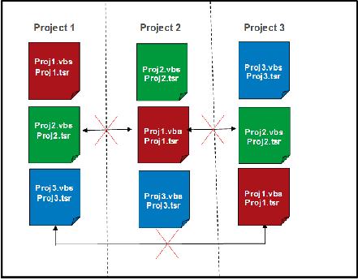
WHY IMPLEMENT ALM TO
SVN MIGRATION?
Limitations of ALM:
All the projects use ALM to create, run and test the scripts.
ALM Does not allow cross project linking.
Each project keeps a copy of required application
function libraries and ORs.
No way to merge the libraries of diff projects, in
case of any changes.
Why Migrate to SVN:
Promote the use of Shared Function Libraries and ORs.
To reduce the execution time.
To reduce maintenance efforts.

Slide 7
ARCHITECTURE
Current State
Future State
Project 1
Project 2
Project 1
Project 2
Project 3
Project 3
Appl1.vbs
Appl1.tsr
Appl1.vbs
Appl1.tsr
App3.vbs
App3.tsr
App2.vbs
App2.tsr
App2.vbs
App2.tsr
App1.vbs
App1.tsr
Shared Function Library and OR
Appl1.vbs
Appl1.tsr
App2.vbs
App2.tsr
App3.vbs
App3.tsr

Slide 8
OBJECTIVES
All this has lead to –
A large number of redundant objects in the object repositories.
More than one object repository and functional library for the same project.
A large number of redundant functions in the function libraries.
Presence of obsolete elements in OR and function libraries.
Objective
Reduce execution time and maintenance effort.
Remove redundancies from the Object Repositories and Functional Libraries.
Merge & Create one shared repository and functional library of each project across other projects respectively.
Implement proper naming conventions.

Slide 9

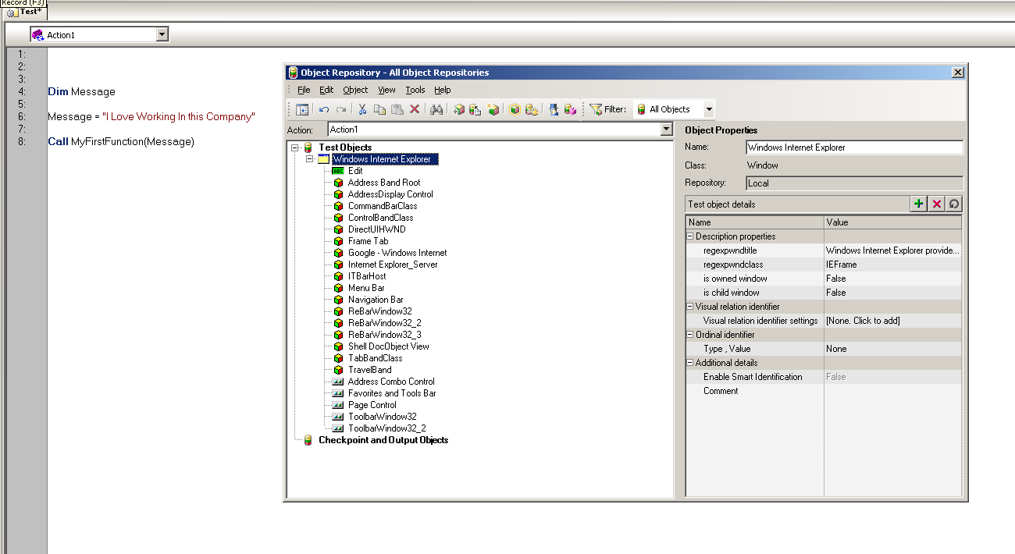

Slide 10
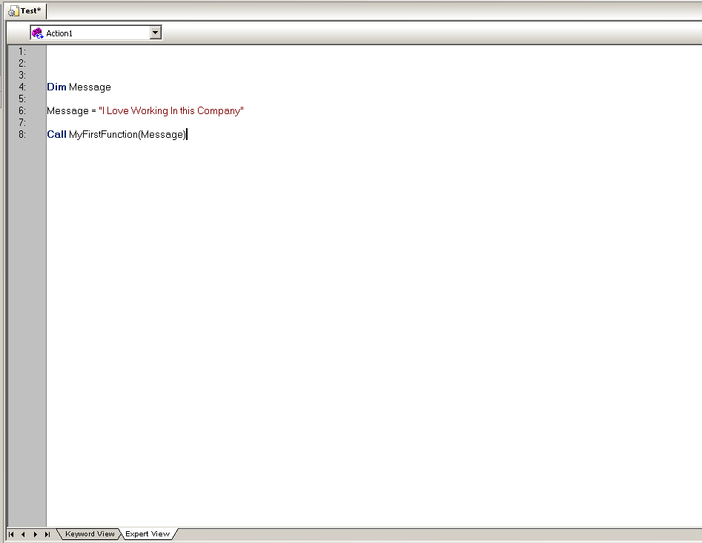
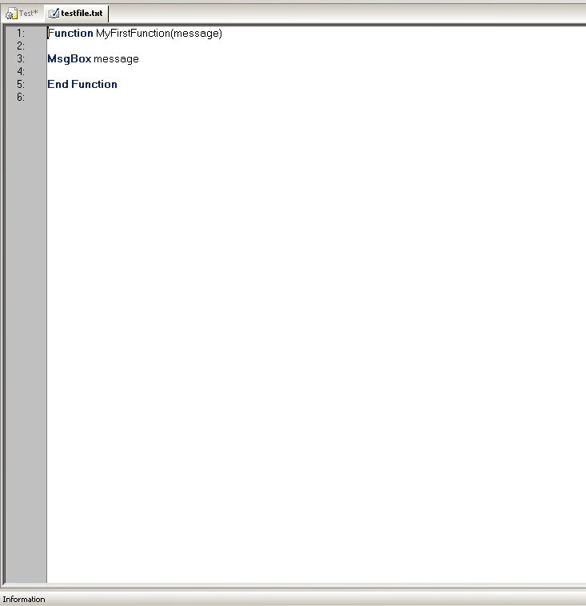
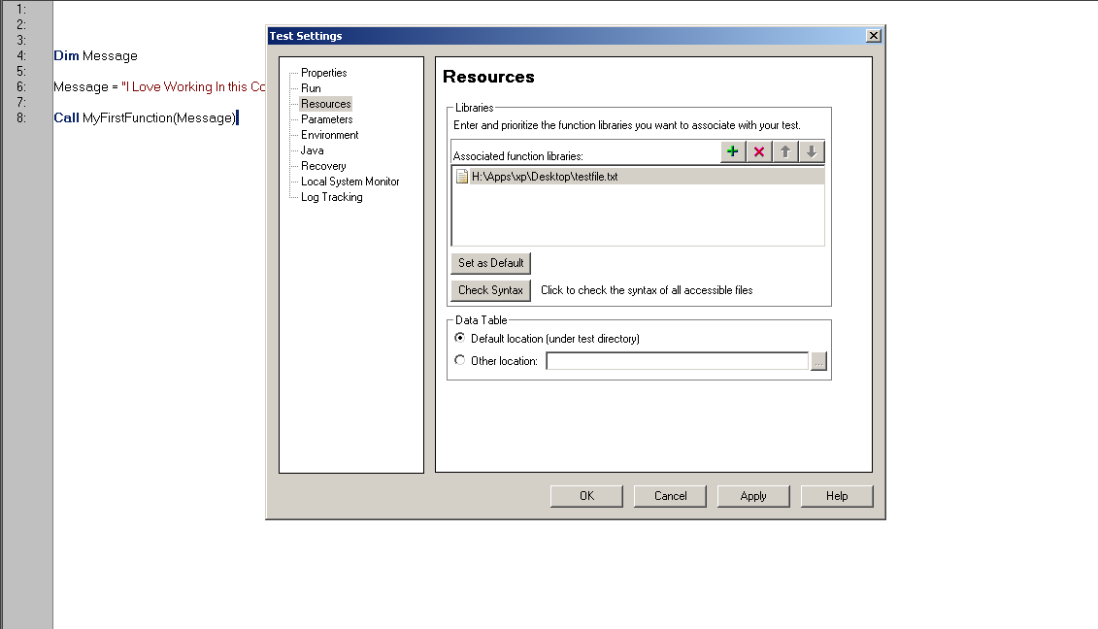
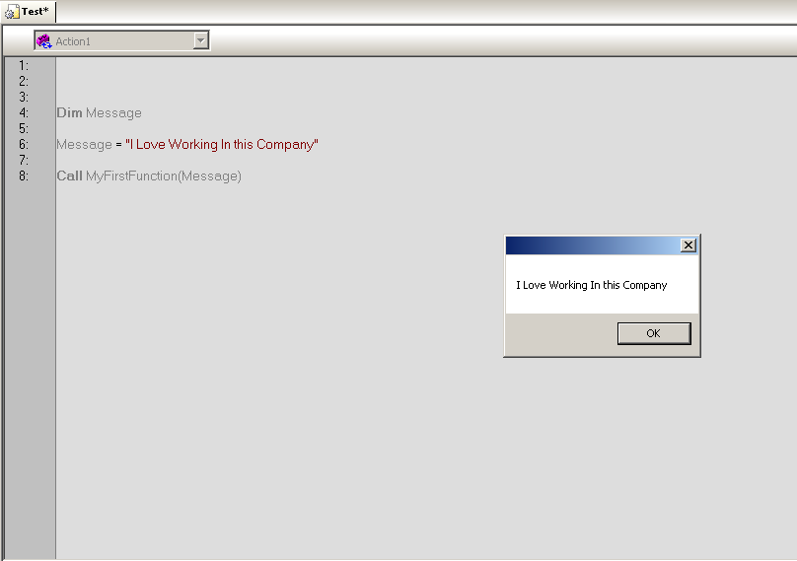

Slide 11
SCOPE AND UTILITY
Applications (written in java)
Application 1:To create an order, or execute a trade
Application 2: Sort of a monitor, to monitor unauthorized orders, active orders, booked orders or executed orders
Application 3: Used for portfolio construction or creation of order. Portfolio Managers use this to monitor the exposure of client’s portfolio
Application 4: Used to monitor any new cash. New cash means entering cash into the system when client has given it’s money to firm for investment
APPLICATION !
APPLICATION 2
APPLICATION 3
APPLICATION 4

Slide 12
FUTURE AND
CURRENT STATUS
Future Expectations
One repository and functional library per project
present in SVN.
Zero redundancies and fully functional scripts.
Current status
Tested our Application 1 Shared OR and Functional Library using various P1, P2 ,P3 test scripts (local copies).
Handed over the Application 1 OR and Functional Library to the testing team.
Prepared a shared OR and Functional Library for Application 2, test cases are yet to be run.
Merging the Application 3 ORs, using merge tool and resolving the conflicts.
App1 OR App1 Lib. App2 OR App2 Lib

Slide 13
PROFESSIONAL AND
TECHNICAL TRAININGS
Technical learnings
Creation of QTP scripts.
Debugging the Scripts. (f5,f10,f11)
Working and understanding various applications that promote trading activity.
Working with the test scripts and functional libraries.
Running the tests manually and by automation.
Learning about processes
Software Testing Lifecycle
Automation processes.
Learning about working in a team
Working closely with the functional team as well as the AST team.
Working together has proved to be an important aspect in working efficiently.
Learning about domain
Various financial terms like stocks, bonds, derivatives, primary market, secondary market etc.
Learnt how the flow of money goes through in BlackRock from client onboarding till client reporting
Learning about etiquettes
Business etiquettes respect seniors
How to write emails to peers and senior management

Slide 14
KEY HIGHLIGHTS OF THE PROJECT
ALM is slow
ALM does not allow cross project linking
SVN is sub versioning and controlling system (shared place)
Synchronization and redundancy problem
Less the number of objects and functions, better the testing process

Slide 15
VIDEO

Slide 16
FEEDBACK
Great amount of Learning done
Your theoretical knowledge is used into practical work.
Helps in developing smart work skills
Formalized project work should be encouraged more.
More faculty visits

